Slide 1
CSE 471: Machine learning
Learning Probabilistic Models

Slide 2
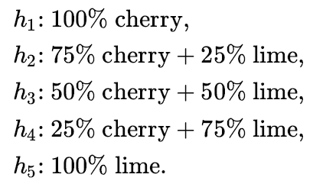



Bayesian Learning
Hypothesis prior
Likelihood
Prediction

Slide 3
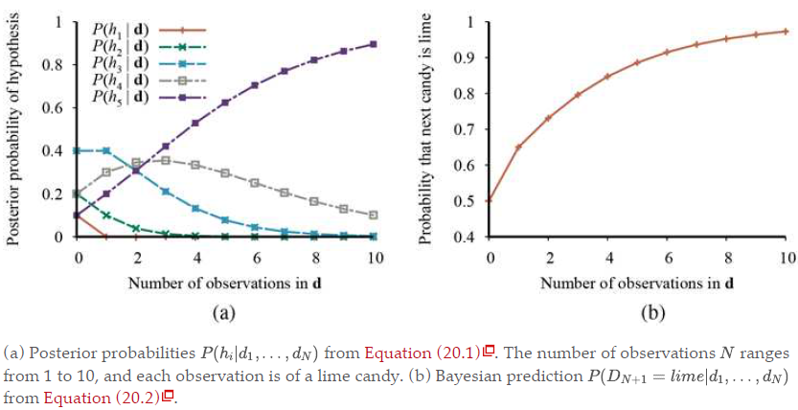
Bayesian Learning
Notes:
For any fixed prior that does not rule out the true hypothesis, the posterior probability of any false hypothesis will, under certain technical conditions, eventually vanish. This happens simply because the probability of generating “uncharacteristic” data indefinitely is vanishingly small.
The optimality of Bayesian learning comes at a price, of course. For real learning problems, the hypothesis space is usually very large or infinite. In some cases, the summation (or integration, in the continuous case) can be carried out tractably, but in most cases we must resort to approximate or simplified methods.

Slide 4
Maximum a posteriori hypothesis
Single most probable hypothesis
An h_{i} that maximizes P(h_{i}|d)
Optimization problem, rather than summation
Often times, it is much easier to solve
Notes:
In our candy example, after three lime candies in a row, so the MAP learner then predicts that the fourth candy is lime with probability 1.0—a much more dangerous prediction than the Bayesian prediction of 0.8.

Slide 5
Maximum-Likelihood hypothesis
Uniform prior assumed over the hypothesis space
Find the h_{i} that maximizes P(d|h_{i})
Notes:
When the data set is large, the prior distribution over hypotheses is less important—the evidence from the data is strong enough to swamp the prior distribution over hypotheses.
That means maximum likelihood learning is a good approximation to Bayesian and MAP learning with large data sets, but it has problems with small data sets.

Slide 6



ML parameter learning

Slide 7
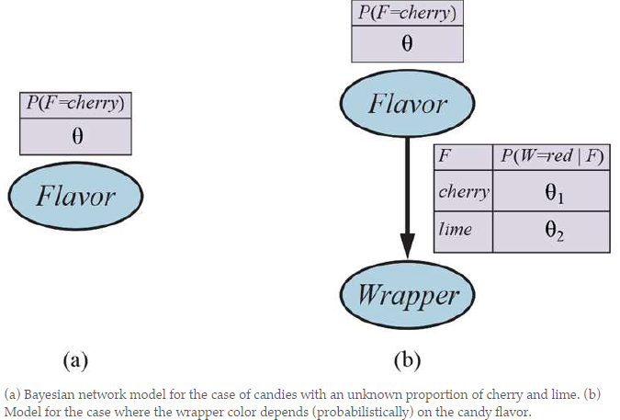
ML parameter learning

Slide 8

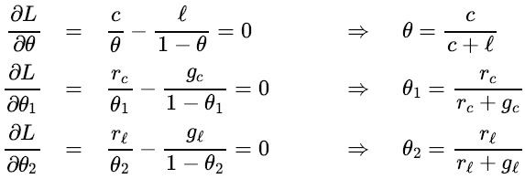
ML parameter learning
Notes:
With complete data, the maximum-likelihood parameter learning problem for a Bayesian network decomposes into separate learning problems, one for each parameter

Slide 9
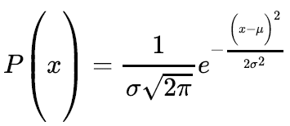
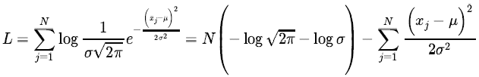
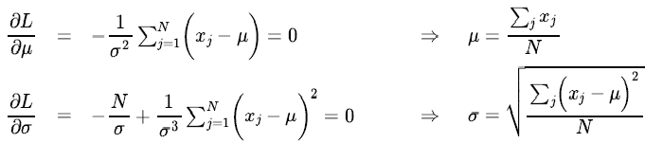
ML parameter learning (Continuous model)

Slide 10
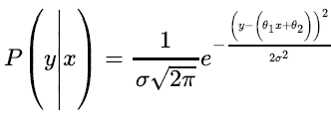

Conditional distribution P(Y|X)
Y has a Gaussian distribution
Fixed standard deviation
Mean is linearly dependent on X
Maximizing the log likelihood with respect to these parameters is the same as minimizing:
Notes:
The final quantity is the L₂ loss function.
Now we can understand why: minimizing the sum of squared errors gives the maximum-likelihood straight-line model, provided that the data are generated with Gaussian noise of fixed variance.

